Slide 1
GTIIT Research Information Management System (RIMS) Workshop-Award Management
RIMS
Funding Opportunities, Applications, Grant & Project
Dec 2021
Research Information Service
RIGS

Slide 2
Content
What is Award Management Module?
Funding Opportunities
Online Funding Application Submission (Internal Approval Workflow)
Manage Your Grant
Viewing Your GTIIT Projects

Slide 3
Award Management
With RIMS’s Award management module, you can track, monitor and manage the entire research life cycle, from current funding opportunities, applications and their success rates, to awards and the related projects, as well as their outputs.

Slide 4
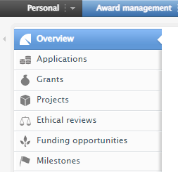
Content Types of Award Management
Overview
Applications
Grant/Awards
Projects
Ethical reviews
Funding opportunities
Milestones

Slide 5
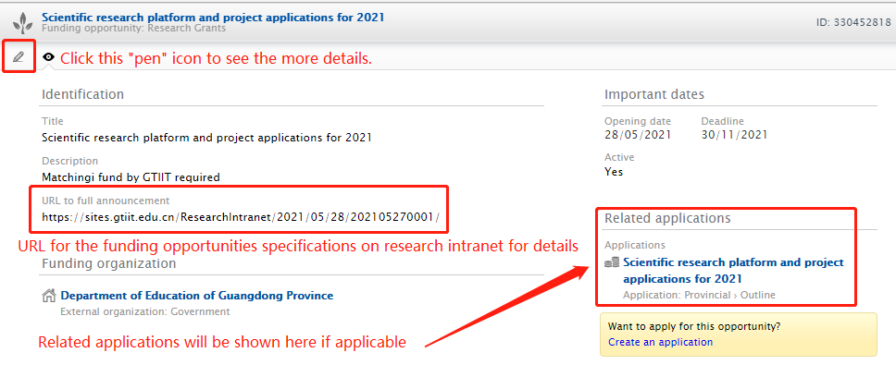
Funding Opportunities
Internal funding opportunities will be published under this section.

Slide 6
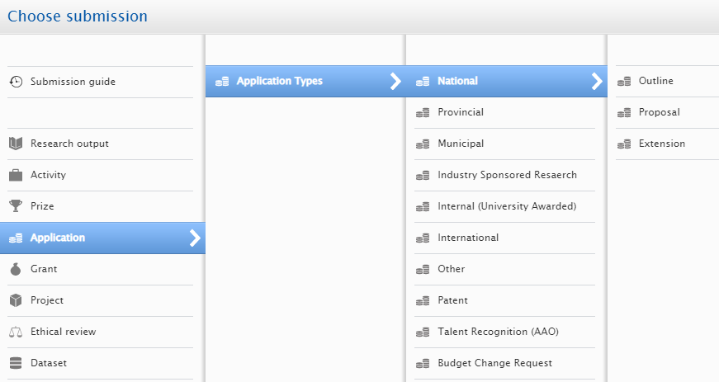
Funding Application Types

Slide 7
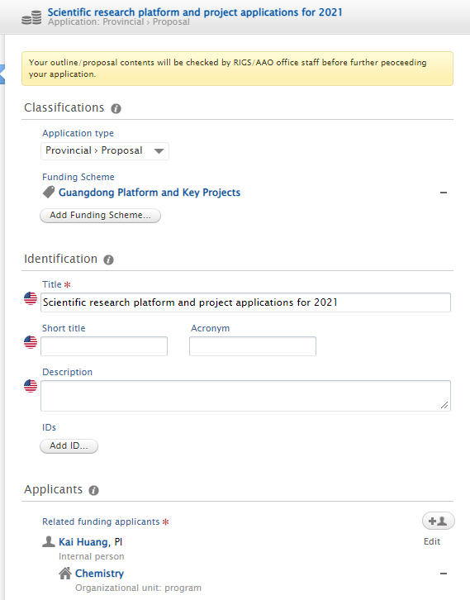
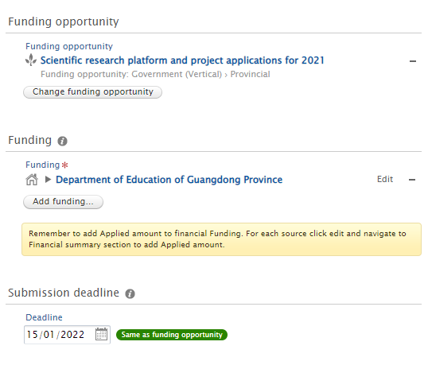
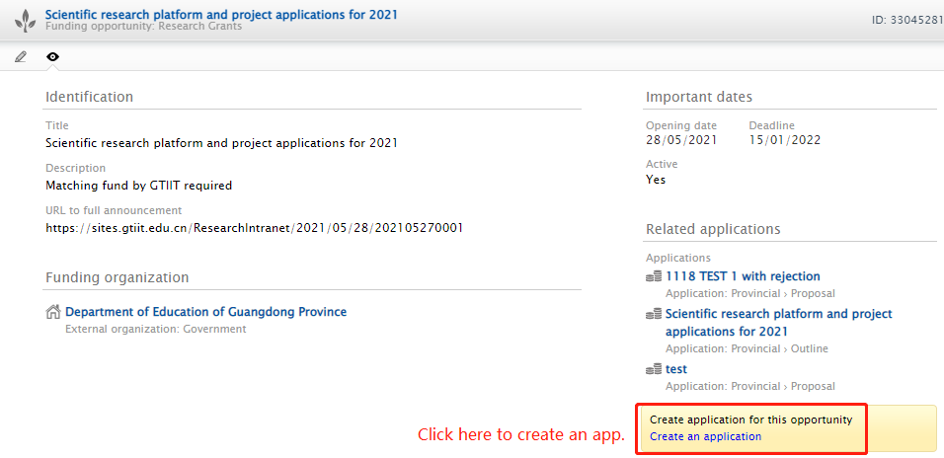
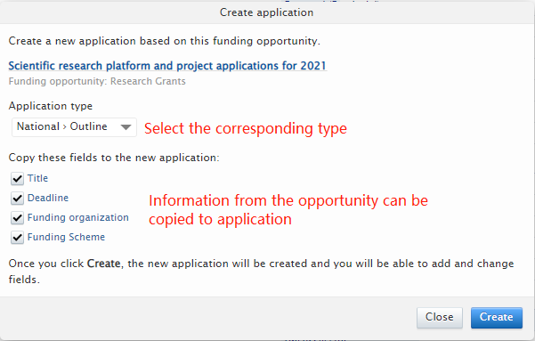
Funding Application Online Submission-Option 1
Create an application from the applicable funding opportunity

Slide 8
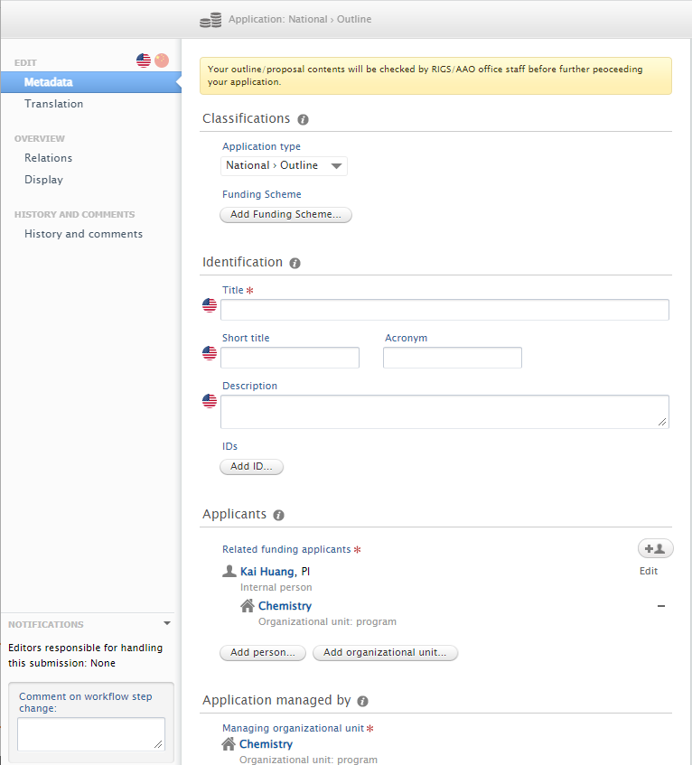
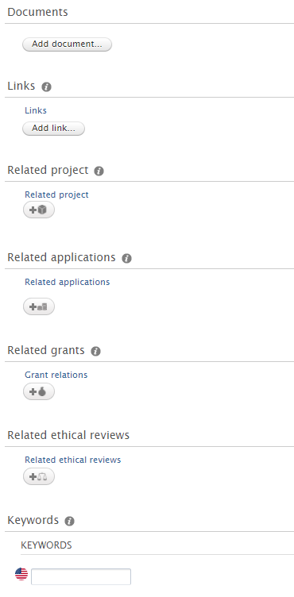
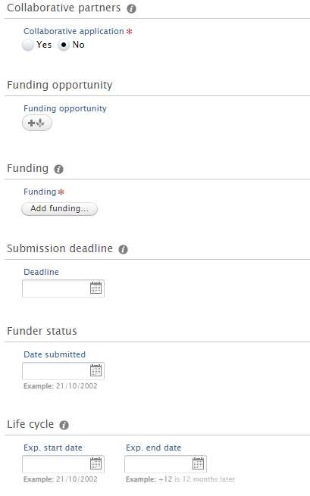
Funding Application Online Submission-Option 1
3. Enter all available information about the item in the editor window:
Title/description/applicants and related team members/members’ organization
Managing organization
Collaborative partners
Funding information
Submission deadline
Project life cycle
Upload related document (research approval form/application form/agreement/contract etc.)
Add related project/applications/grants/ethical reviews/keywords
4. Set visibility before sending/save
In the Relations section, add links to any other records that have a real-work connection to the current item you are adding. Click the icon under each listed content type and begin typing the name of the related record to link to see matches.

Slide 9
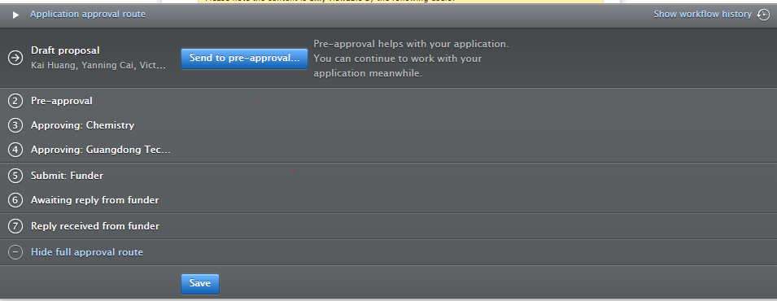
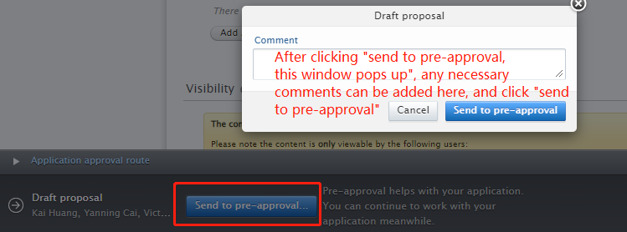
Funding Application Approval Workflow
At the bottom of the application edit window, you can see the required application approval routes/workflow, you can click “Send to pre-approval” after everything is completed.

Slide 10
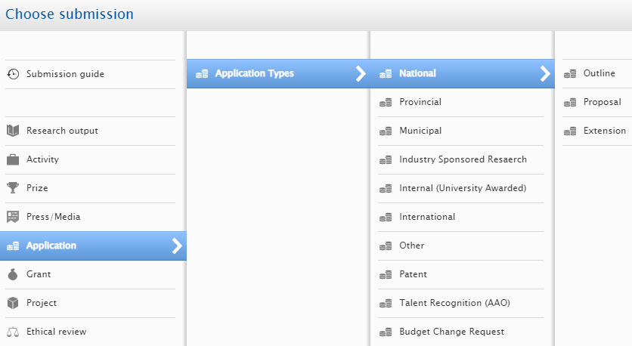
Funding Application Online Submission-Option 2
1. Click button in the task pane:
2. Click in the left pane and drill down until you locate the precise type of the item you want to add.
Application types:
Select application type as “proposal”
Application without Quota Limitation
Select application type as “proposal”
Application with Quota Limitation
Matching fund required by GTIIT which requires financial eligibility checking

Slide 11
Funding Application Approval Workflow
Draft Proposal (add basic/required details of the application)
Pre-approval (initial checking on the proposal content by RIGS/AAO)
Checking: Program (Financial related items checking by Finance)
Approving: Program (1st level approval by Head of program)
Approving: University (final approval by PVCAA/VC)
Submit: Funder (the application approval is complete and ready to be submitted to the selected funder)
Reply Received from: Funder (Once a reply from the funder has been received it can now be marked as either Awarded or Rejected)
Awaiting Reply from Funder
Related Roles
Applicant
Gov.: Yanning Cai (RIGS)
Industrial: Victor Huang (GTEC)
Talent： Samantha Chen (AAO)
Zoe Xi (Finance)
Program Head
PVCAA/VC
System editor of application
Administrator of application
Check more on Application Submission Guidelines

Slide 12
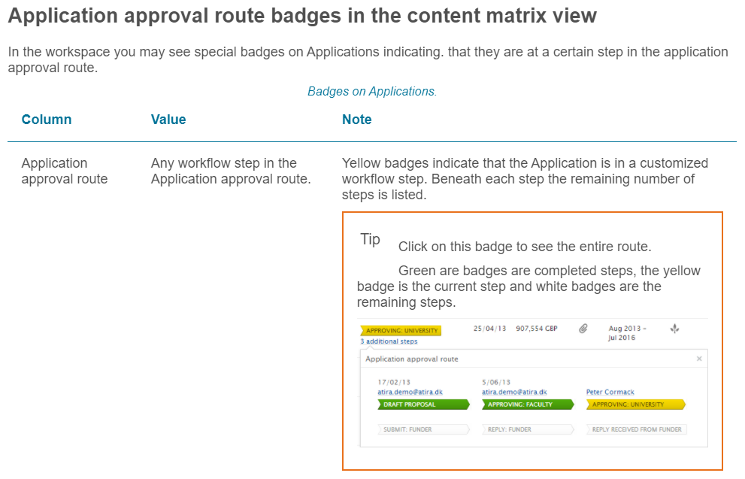
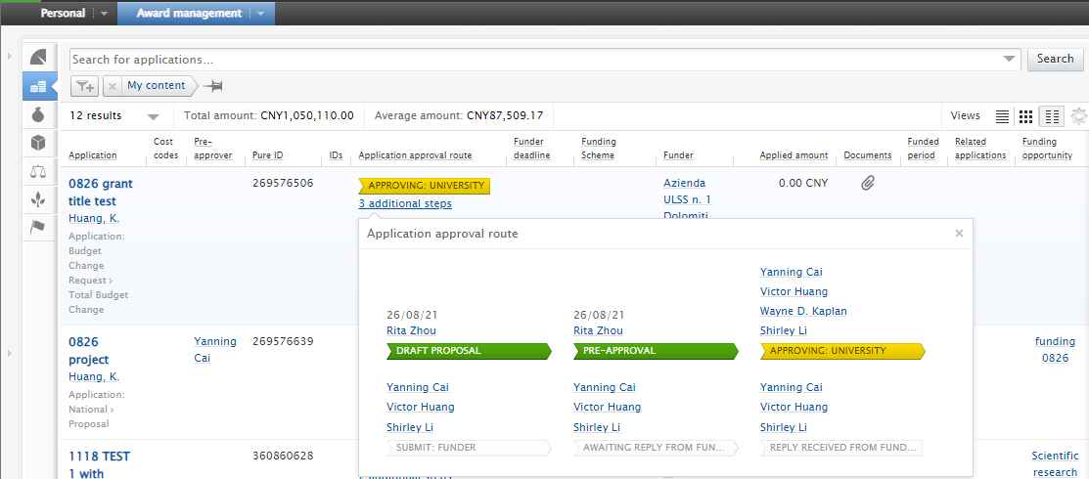
Funding Application Approval Workflow Status

Slide 13
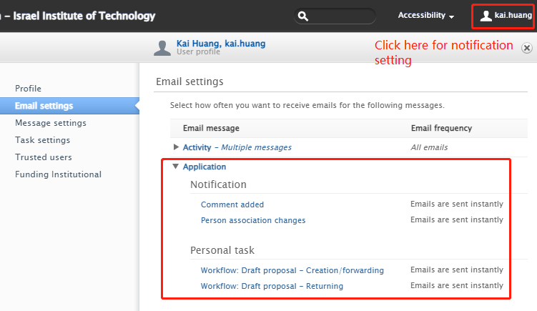
Notification on Application

Slide 14
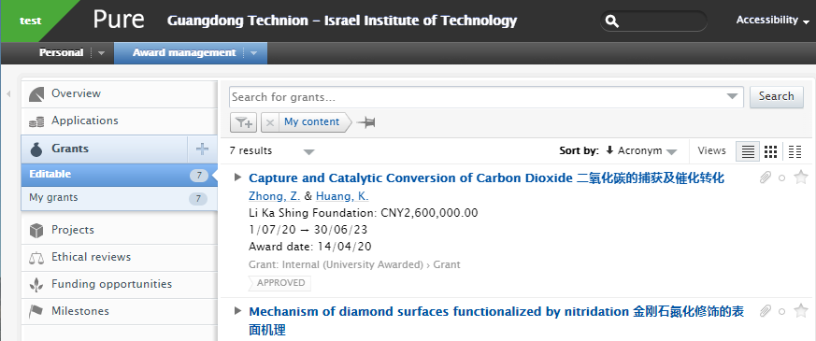
Manage Your GTIIT Grant/Award
Click “Award management” to show the content types
Tip: click to expand the tabs in the left navigation.
Click “Grants” to show the grant information

Slide 15
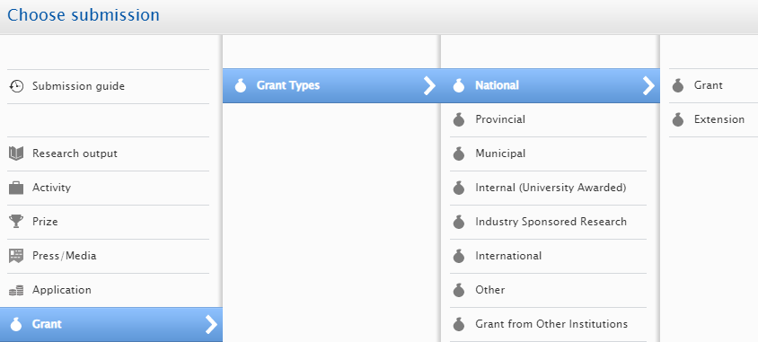
Manage Your GTIIT Grant/Award
GTIIT grants are entered by RIGS office.
An Award in Pure is a record with information about research funding granted by a funder. Many fields are shared with the Application content type, though award records can hold unique information about the amount awarded and non-financial contributions.
Grant Types:
National
Provincial
Municipal
Internal (University Awarded)
Industry Sponsored Research
International
Other
Grant from Other Institution

Slide 16
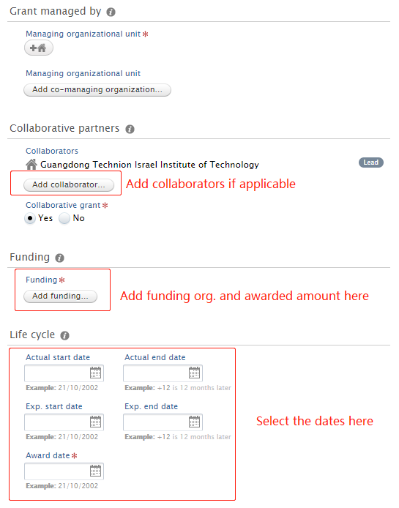
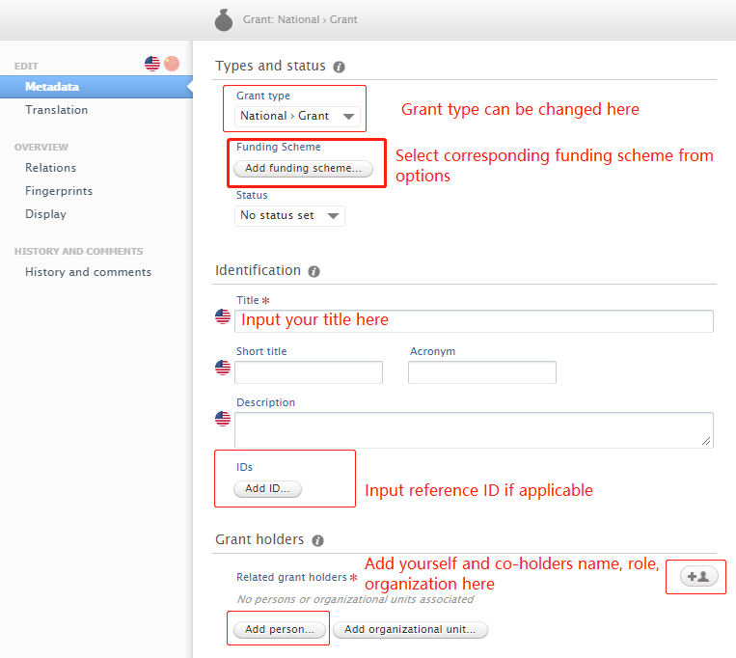
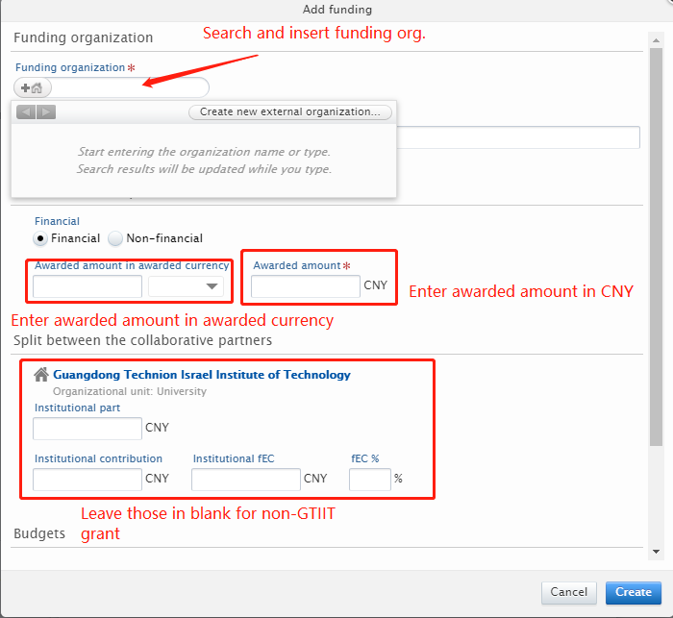
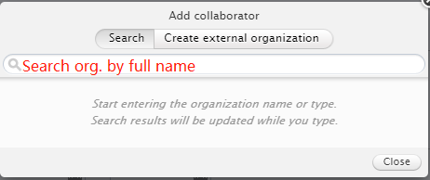
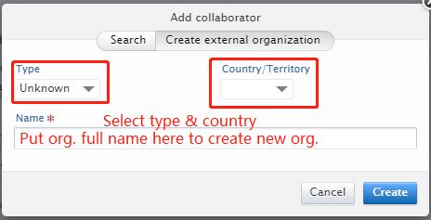
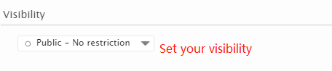
Manage Your Grant

Slide 17
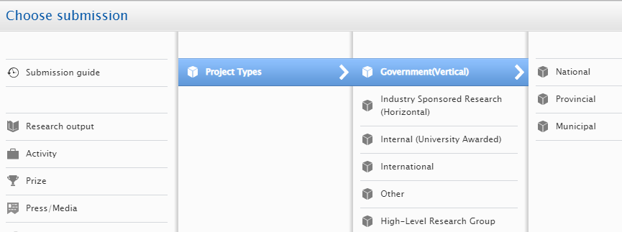
Manage Your Project
A Project in Pure is a record with information about a research project, such as the participants and collaborators, lifecycle, grant applications and awards, links to research output, activities etc..

Slide 18
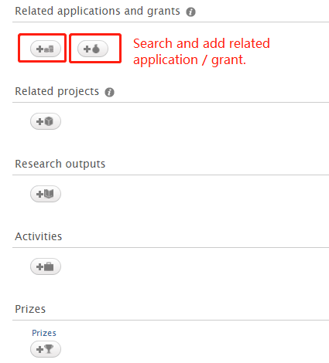
Projects and Relations between Award Management Content Types
Only GTIIT projects will be registered and entered by RIGS office.
For administrative and reporting purposes it is useful to link Award management records of different content types together. For example, a funded research project (with the content type Project) should be linked to its funding applications (with the content type Application) and the awarded funding from the successful application (with the content type Award). If an ethical review (content type Ethical review) was conducted, this can be linked with the relevant Application record.

Slide 19
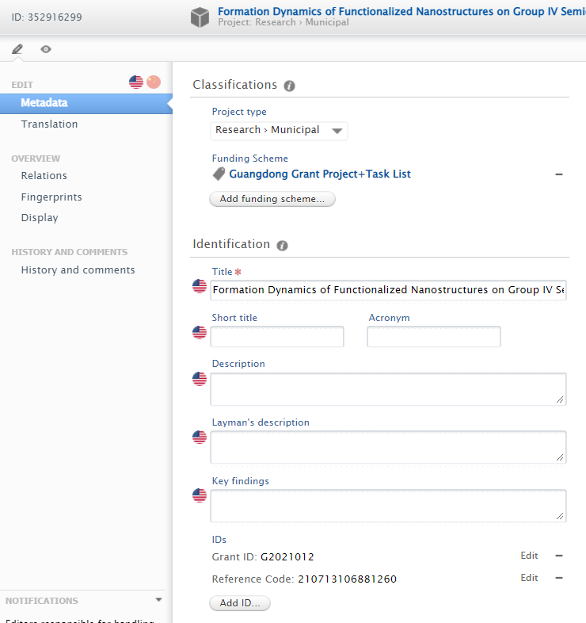
Fields on Projects
Project title: ensure English title is provided, add Chinese title if applicable
Format: English title + Space + Chinese title
e.g. This is project title 这是项目名称
Grant ID or Project ID is internal used ID, managed by RIGS
Reference code: code from funder

Slide 20
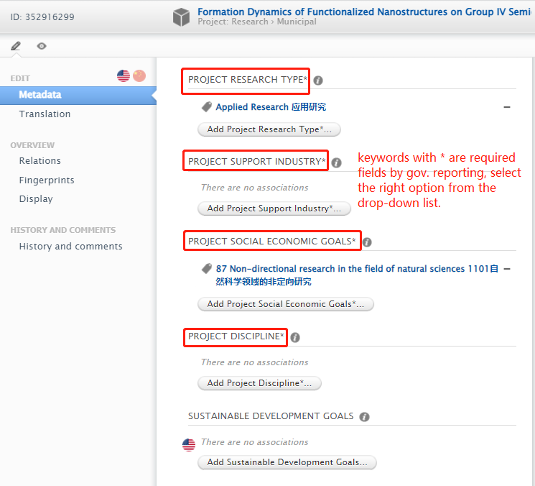
Customized Keywords on Projects for Gov. Reporting
Only GTIIT projects will be registered and entered by RIGS office.
For administrative and reporting purposes it is useful to link Award management records of different content types together. For

Slide 21
Thank You
RIGS
rigs@gtiit.edu.cn

