Slide 1
GTIIT Research Information Management System (RIMS) Workshop-Core Module & Portal
RIMS
Profile, Publication, Activity, Prize & Portal
Dec. 2021
Research Information Service
RIGS

Slide 2
Content
What is RIMS?
Manage Your Profile
Manage Your Publication
Other Content Management
Activity
Prize
What is Research Portal and How it Works?

Slide 3
What is RIMS?
3
GTIIT’s RIMS (Research Information Management System) is powered by Elsevier Pure, it is a faculty activity reporting tool to keep up-to-date records about publications authored and other academic activities undertaken by our researchers.
RIGS-GTIIT

Slide 4
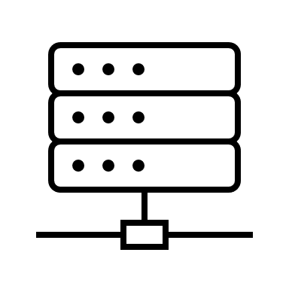
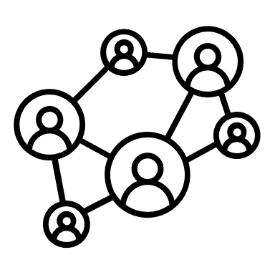
4
Portal
Research output (publications, patents)
Activities
Prizes
Research Data Management
Profile Management
RIMS
Funding opportunities
Funding application
Grants
Projects
Ethical Reviews
Research Networking
Reporting
Award Management
RIGS-GTIIT

Slide 5
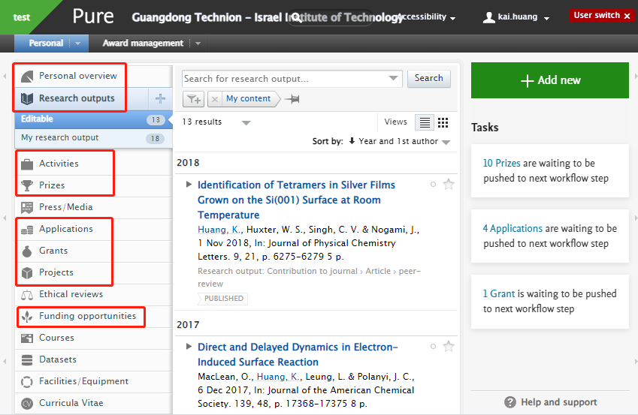
Current Available Sections
Research Units (academic organization units of GTIIT)
Profile
Staff: Researcher
Student: Research Fellow/PhD/Master/Research Assistant
Research Outputs (Publications/Patent)
Activities
Prize
Grants & Projects

Slide 6
Current Contents in RIMS & Portal Visitors
5977 Research Outputs (Publication & Patent)
863
Activities
282
Prizes
273
Grants
13,933 Global New Visitors
136
Countries & Regions
50%
Organic Search

Slide 7
Manage Your Profile

Slide 8
Your Role in RIMS
Researcher as:
A person: you yourself is an entity in RIMS
A personal user: be able to log into RIMS, add/edit and view your own information

Slide 9
Demo
Staging server link:
https://research-dev.gtiit.edu.cn/admin
Log in with your GTIIT email account

Slide 10
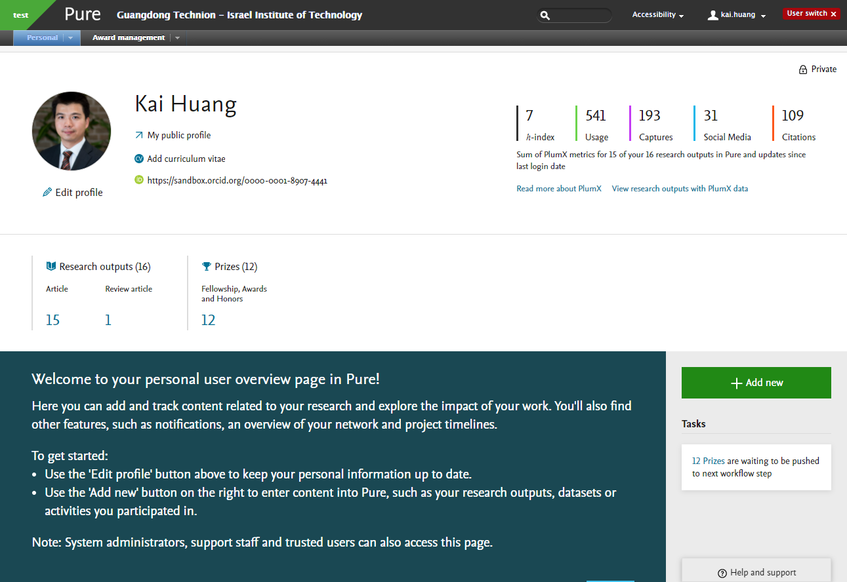
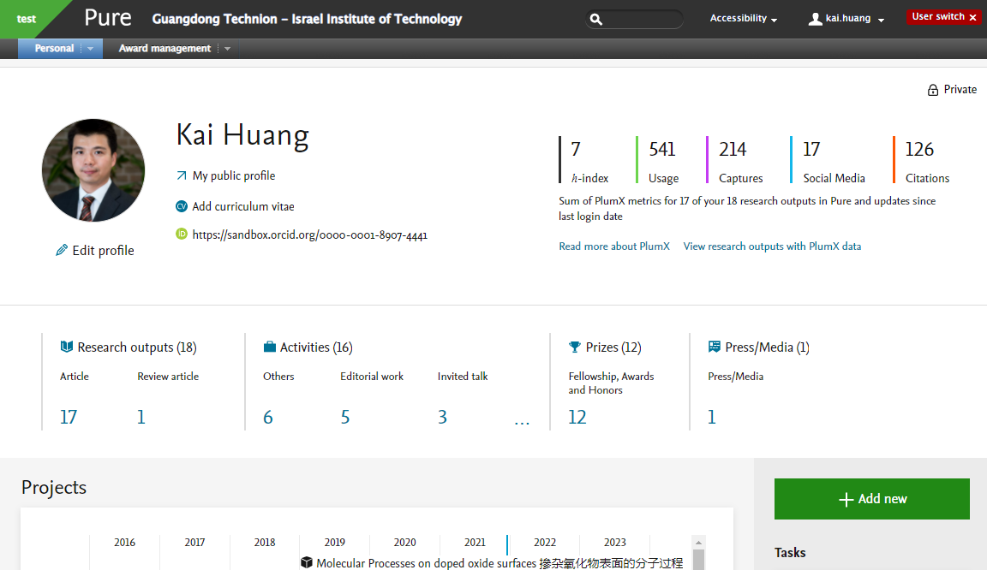
RIMS Interface Initial View
Personal Overview

Slide 11
About Your Profile- Editable and read-only fields
Your personal profile consists of general information about you, such as identifying info and info about your position and research, as well as the sum of records related to you, such as publication you authored.
Read-only fields:
Information is populated and synchronized from HR system
First name/last name/academic title/nationality/organization/email etc..
Editable fields:
Information is manually added
Profile photo/Profile overview/Research interests etc..

Slide 12
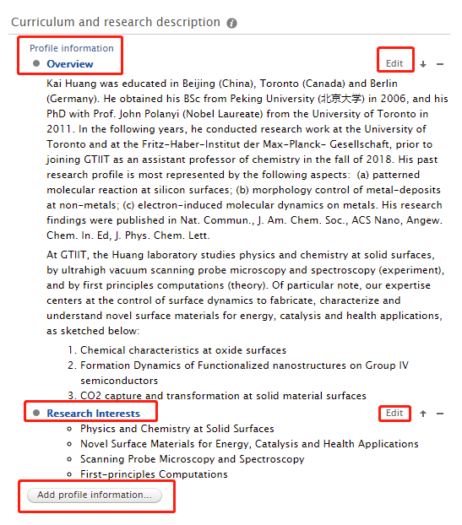
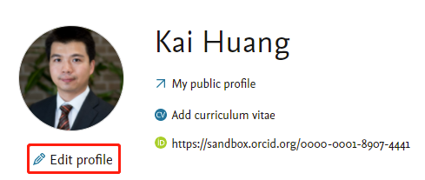
Edit Your Profile
Click “Edit profile”
Go to 'Curriculum and research description'
Select 'Add profile information’
Select the category for the information you want to add. The categories are:
Overview
Research interests
Research Group
Or select “Edit” to edit the existed info category

Slide 13
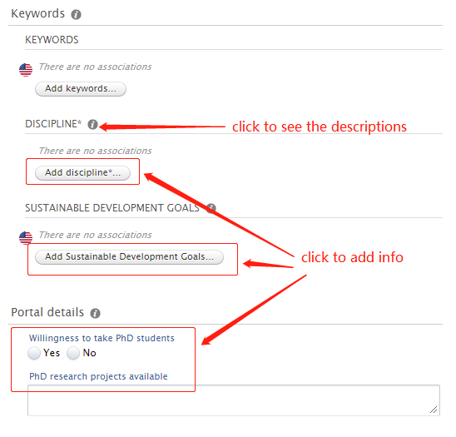
Edit Keywords and Others on Your Profile
Discipline: enter the discipline of your highest academic qualification based on the options.

Slide 14
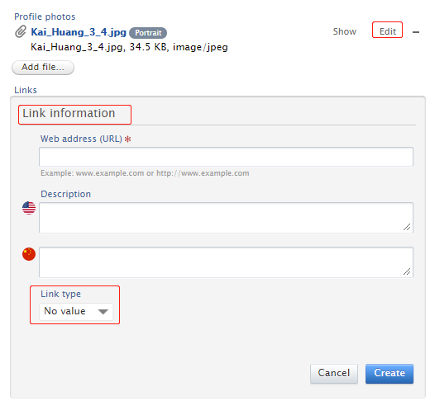
Edit Your Photo and Links
Preset Link types (social media or personal websites):
LinkedIn
Google Scholar
Mendeley
ResearchGate…
Select a link type from the drop-down menu, The links will show up as icons below your profile photo. If you select a link type that was added by university, the link will show up as a globe icon.
Contact us if your type is not on the list.

Slide 15
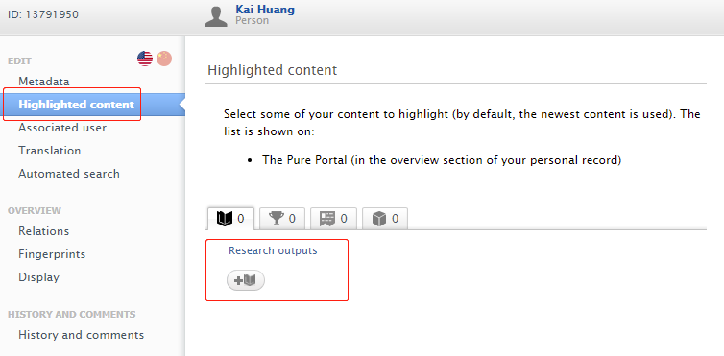
Highlighted Content
By default, up to five of the most recent outputs, projects and datasets are displayed on the profile overview page (below the network map).
To change which records are displayed:
Click on ‘Portal profile’ (on the left).
In the section ‘Highlighted content’ click on the ‘+’ icon to search for the records (click on the spacebar to show a list of records).
Click on a record to add it.
Repeat for up to five records per content type (output, project and dataset).
Click on ‘Save’.

Slide 16
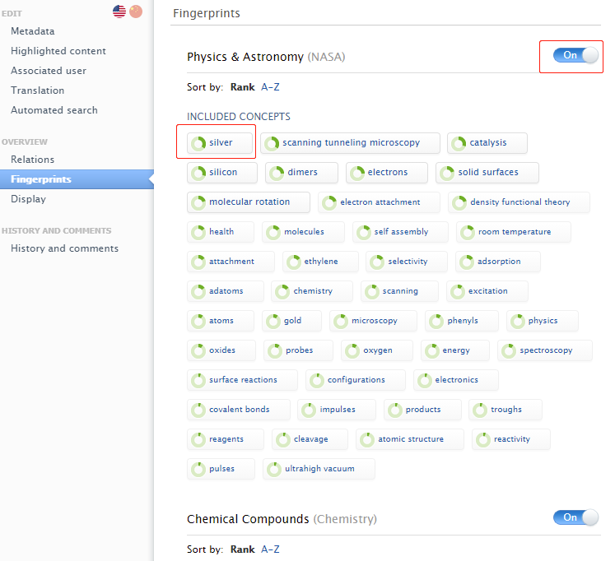
Changing Your Fingerprints
To remove your fingerprint concepts:
Click on the ‘Fingerprints’ tab (on the left).
Select and hover over the concept you want to remove.
Click on the red cross.
To switch the fingerprints off on your profile page:
Click on the blue ‘On’ button and this will change to ‘Off’.
Click on ‘Save'.

Slide 17
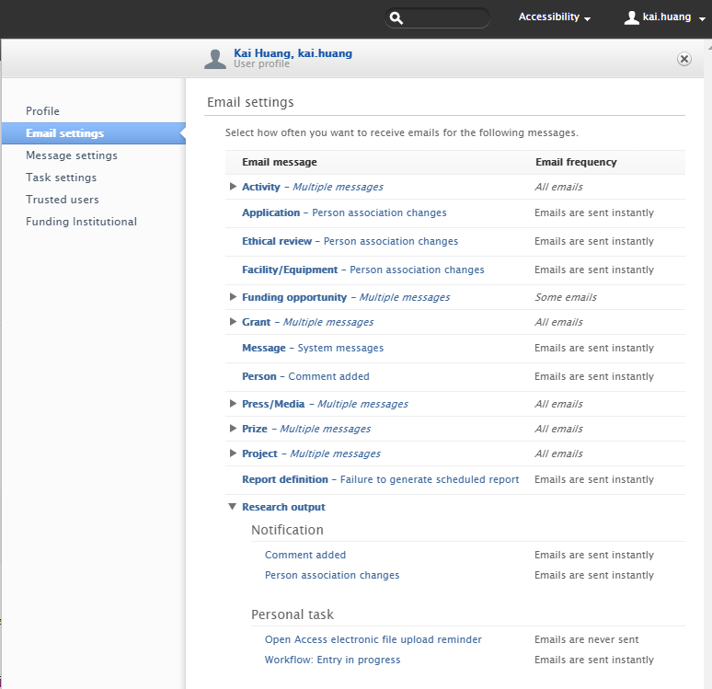
User Settings-Email Notification Preferences
Click your username in the header
Click Email settings tab in the left navigation pane
Navigate to the event that you want to change your email notifications in the E-mail message column.
In the Mail frequency column next to the event, select whether the event should trigger an email notification

Slide 18
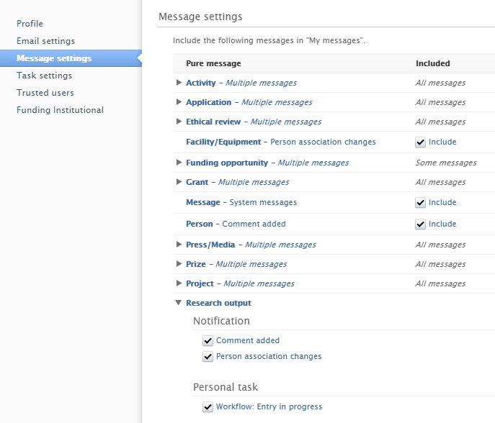
User Settings-Message Settings
Click your username in the header
Click Message settings tab in the left navigation pane
Navigate to the event that you want to change your message notification in the Pure message column.
In the Included column next to the event, select whether the event should trigger an message notification

Slide 19
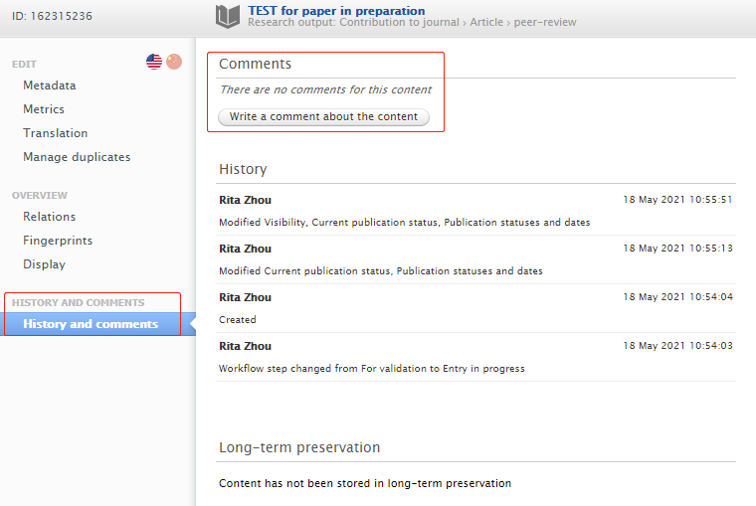
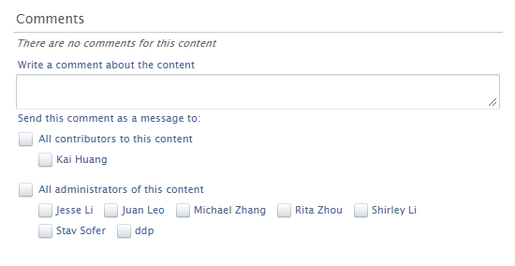
History and comments
Make sure you select the checkboxes next to the names you want to see the comment on the record, otherwise, no message is sent.

Slide 20
Manage Your Publication
Publication Types at RIMS:
Peer-reviewed journal articles, Review articles
Editorials, letters, comment/debate/short survey
Books, chapters in books
Conference papers
Other contribution

Slide 21
Profile Refinement Service (PRS)
Import your publication automatically
PRS is a Scopus author disambiguation service offered for Pure. It helps us to populate research output related to researchers by making use of our researchers' publication information in Scopus (based on Scopus author ID/ORCID). In Elsevier they have a PRS team that handles PRS by using both algorithms and manual search for publications.
Quality factors:
Name (first and last name)
Name variants (if the person has changed name or publishes under another name)
Relation to department level - affiliation (including historical)
Email address(es)
Scopus IDs is needed
ORCID (optional but helpful)

Slide 22
PRS Process
New publication indexed in Scopus
Disambiguated by PRS team and imported to their database
Import to RIMS
After 1st bulk population RIMS with a disambiguated publication list for the researcher, disambiguation happens on an ongoing basis and any new Scopus publications that are disambiguated with high confidence are added to the RIMS profiles on a weekly basis.
2-4 weeks
Tip: You are encouraged to manual import/add it once the publication is accepted/published.

Slide 23
Search for a Publication
Click “Personal” tab in the top navigation
Click “Research Outputs” under your personal photo
Either:
Type a search query in the search bar and click “Search”
Add or remove search filters (by default, it is filtered with only your own publications)
Click the name of the item to open the editor window for more info about the record

Slide 24
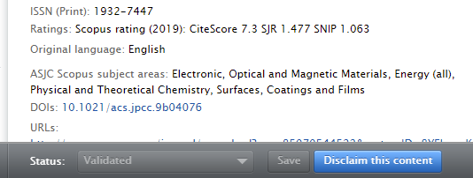
Claiming and Disclaiming Authorship
If a co-author of an item of your research output has already entered the item into Pure and has forgotten to associate you with the item, you can claim that you should also be associated with (added to) this content. If you are added to a record, you can also make changes to the record depending on its workflow state.
Similarly, if someone associates you with an item of research output and this is incorrect, you can disclaim the record.
Before adding a co-authored publication, search and check whether another internal author has already entered some details in RIMS,
in the footer on the editor window.

Slide 25
Other Ways to Add Your Publication
If the new publication is not indexed in Scopus, or not be imported from Scopus after a certain period (2-4 weeks), you will have to input into Pure by following ways:
Click on the green ‘Add new’ button at the right middle of the screen, select ‘Research output’ and choose one of the following options:
Create from template: select the appropriate template and manually fill in the details
Import from online source: search a database to automatically populate your template (you can use this option if you have the DOI for the publication)
Import from file: upload if your publications is in BibTex or RIS format

Slide 26
Importing from Online Source
Select an online source to search your publication by title/doi etc.
The search result will tell you whether it is already existed in the system or a source record is available to import
Click “Import” if it’s new
Have an initial check of each listed item and click “import and review” to check each field
For GTIIT affiliated publication, validation by RIGS required for each new publication updated:
Entry in Progress:
For validation:

Slide 27
Check/Input the Publication Content
Publication Status
In preparation: the date the work is being prepared for submission. By default, the record's visibility is set to ‘Backend - restricted to Pure users’ and so will not appear on the research portal
Submitted: the date the work was submitted to a journal for peer review. By default, the record's visibility is set to ‘Backend - restricted to Pure users’ and so will not appear on the research portal
Accepted/In Press: the work is approved, following all peer review changes. You should upload the version of the work that was last sent to the publisher within three months of this date. (This version is also referred to as a ‘post-print’, ‘author’s accepted manuscript’ or ‘author’s final version’.) By default the record's visibility is set to ‘Public - No restriction’ and will appear on the research portal once it has been validated by the RIGS team
E-pub ahead of print: the date the publisher-formatted version was made available on the publisher’s webpage. The Pure record can be updated to include a link
Published: the date the work was formally published. The Pure record can be updated to include volume, issue and page numbers
Fields marked with a red asterisk (*) are mandatory
Add as much information as possible to increase the visibility of your research. An abstract is particularly useful
Leave the following sections empty: ‘Bibliographical note’, ‘External publication ids’
Remember to click on ‘Save’ before you close your record
For GTIIT affiliated publication, validation by RIGS required for each new publication updated:
Entry in Progress:
For validation:

Slide 28
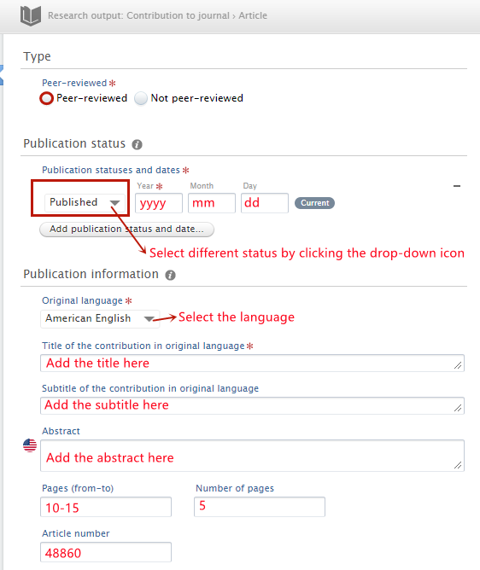
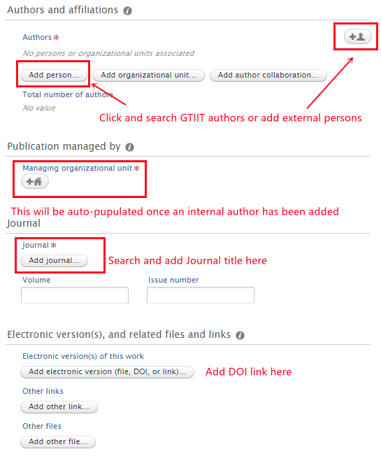
Check/Input the Publication Content
You may have multiple organizational affiliations in Pure, including research centers and institutes. If not all are relevant to a particular research output, you can remove them by clicking on the minus sign next to the name. Conversely, you can add an organizational unit by clicking on ‘Add organizational unit …’
To add additional authors to an output, click on ‘Add person …’ and either select a name from your previous co-authors, search for a GTIIT research member, or create an external person.

Slide 29
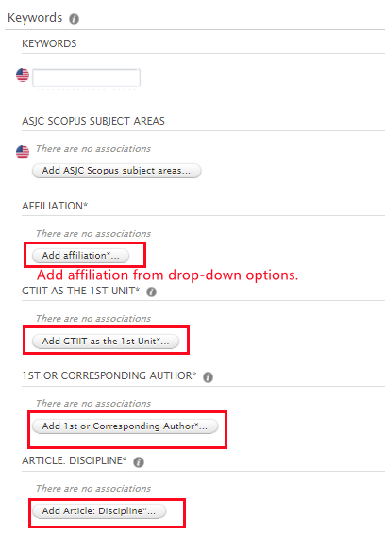
Adding Keywords
Customized keywords with * of your publication are required to be filled:
Affiliation:
Select as GTIIT with GTIIT affiliation
Select as “non-GTIIT” with no GTIIT affiliation
1st Unit:
Select it when you put GTIIT as the 1st unit under your affiliations of the publication
1st or/and Corresponding Author:
(S): refers to your student (research fellow/PhD/Master/Research Assistant/UG)
1st Author: it is for both the article and book
Editor: when it is an edited book
Non 1st Author (Book): it is only used for the book type
Article: Discipline
Select it from the option list for different types of article/paper etc..

Slide 30
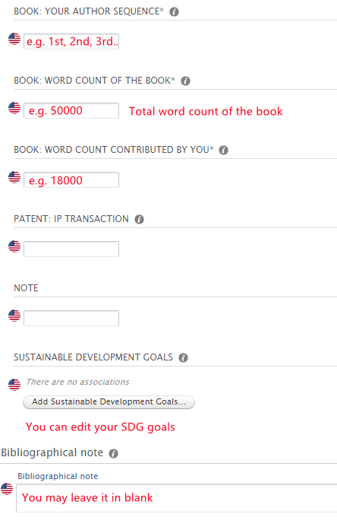
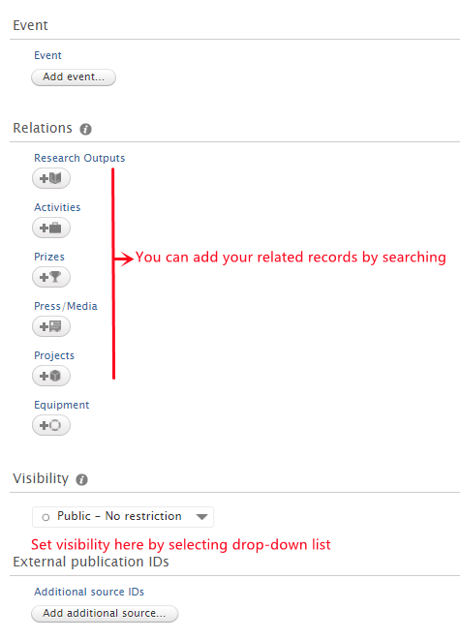
Adding Keywords
Book: your author sequence
Fill in your author sequence if this publication is a book
Book: word count of the book:
Fill in the total word count of the book
Book, word count contributed by you:
Fill in the word count of your contributed part

Slide 31
Visibility Settings
‘Public - No restriction’: content could be viewed publicly, although currently only publications are publicly accessible through the Research Portal
‘Campus - Restricted to specific IP range’: visibility is restricted to viewers with a specific IP range set to reflect being on-campus at GTIIT
‘Backend - Restricted to Pure users’: content visible to a small number of Pure users
‘Confidential - Restricted to associated users and editors’: the email addresses of those who can view your information will be displayed. This includes the contributors, editors (administrators) and Pure administrators in RIGS and Elsevier and IT Department

Slide 32
Publication Validation Workflow
All GTIIT affiliated research outputs and the attached full text documents are validated by the RIGS.
External affiliated research outputs are not validated with the workflow below.
Entry in Progress
For Validation
Validated
Correction required after validated?
Import/add new publication
Check the content prior to sending it “For Validation”;
Mark it as complete and ready to be validated.
Content can’t be edited in this status
Send info to change after being validated to RIGS

Slide 33
Other Content Management
Activities
Prizes

Slide 34
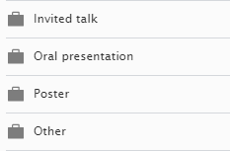
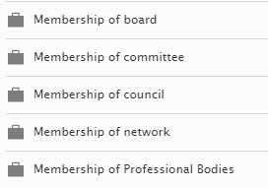
Manage Your Activity
Talk & Presentation
Membership
Peer-review &editorial

Slide 35
Manage Your Prize
High-level talent will be managed by RIGS.

Slide 36
Research Portal
The Research Portal is a visually appealing, easy-to-use online solution for researcher profiling and research networking capabilities. It showcases researcher profiles publicly on the web in an easily-searchable form to facilitate access to their work.
The Research Portal is populated with content from RIMS’ database, though it only receives content which passes successfully through a series of filters which consider the workflow step of the content and any visibility/confidentiality settings.

Slide 37
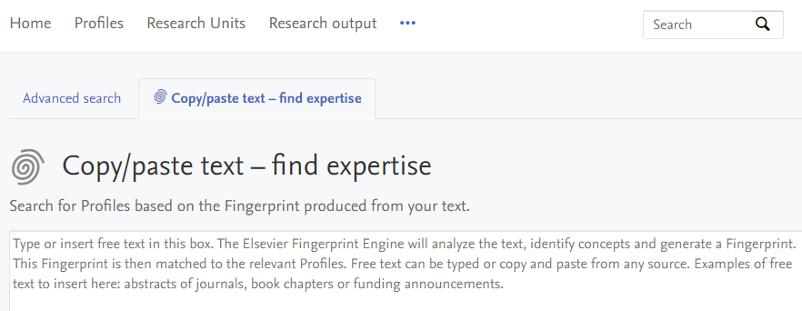
Search the Research Portal
The portal offers search based on:
basic text search (search in matching text).
advanced search form (advanced search).
single-concept search (search as concept).
person search based on similarity to copy-pasted text (search as copy/paste).
Tip: The Portal default search box found on all pages uses single-concept search by default with the basic text search as a fallback.

Slide 38
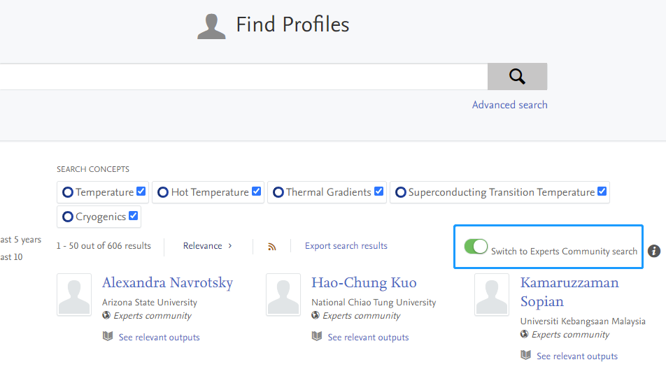
Experts Community Search
Search and be searched by the global researchers
Go to profiles, this feature only shows on the profile tab
Type an expert name or keyword of research, click search icon or press “enter” on the keyboard
It shows the GTIIT profile search result first, then click the toggle called “Switch to Experts Community search” on the middle-right of the screen, under search bar.
Then you can get the global researcher search result

Slide 39
UN Sustainable Development Goals (SDGs)
It helps demonstrate the ways in which our researchers support the SDGs through collaboration with other countries, the promotion of best practices and the publication of data…
Hover over an SDG logo to see its full name
Click on it will show an overview of the content in the Portal tagged as relevant to that goal
Select one of the content types to navigate to a pre-filtered search overview page for that type
Profiles/publications can also be filtered by SDG goals by selecting them on the left navigation pane

Slide 40
Thank You
RIGS
rigs@gtiit.edu.cn

