Slide 1
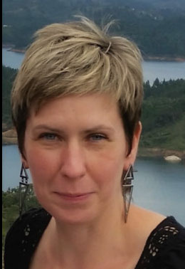
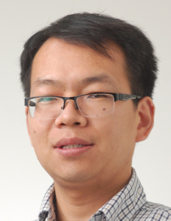
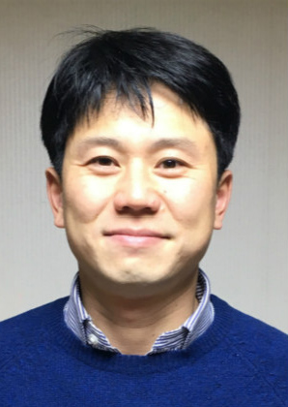
GTIIT Researchers affiliated with SEHM
Researcher | Program | SEHM as first priority | SEHM as second priority | Research background and lines and comments
Aleksandra Baron-Wiechec | Materials Science and Engineering | X |  | Surface engineering and corrosion laboratory.
Peng Xu | Chemical Engineering | X |  | Metabolic engineering, synthetic biology, biochemical engineering, systems biology, computational modelling, engineering the chemistry (the mass flow) and the information flow inside cells to reprogram cellular functions
Sehoon Park | Chemistry |  | X | Organocatalysis, organometallic chemistry, olefin polymerization

Slide 2
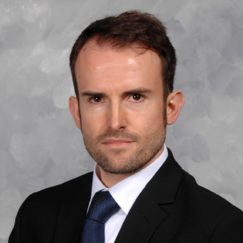
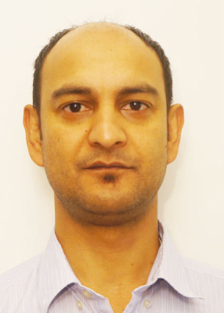
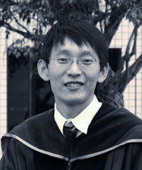
GTIIT Researchers affiliated with SEHM
Researcher | Program | SEHM as first priority | SEHM as second priority | Research background and lines and comments
Damiano Padovani | Mechanical Engineering (Robotics) | X |  | Fluid power, mechatronics, soft robotics
Khadga Jung Karki | Physics |  | X | Functional nonlinear spectroscopy, phase modulation, fluorescence and photocurrent detected two-dimensional spectroscopy, coherent excitations, semiconductors, superconductors
Xinpeng Xu | Physics | X |  | Soft matter physics, biological physics, active matter, cell mechanics, colloidal suspensions, polymer solutions, polymer gels, wetting dynamics

Slide 3
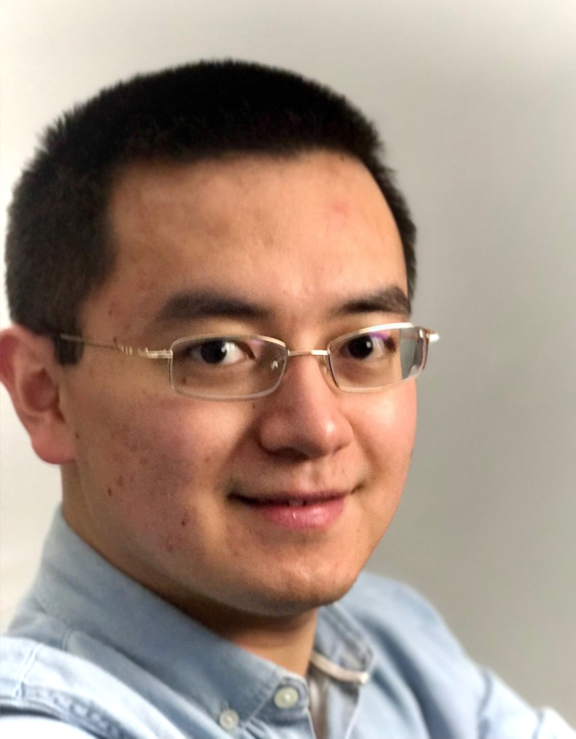
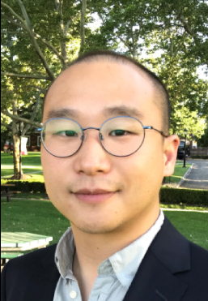
GTIIT Researchers affiliated with SEHM
Researcher | Program | SEHM as first priority | SEHM as second priority | Research background and lines and comments
Bin Li | Mechanical Engineering (Robotics) | X |  | Surface mechanics, mechanics of soft materials, mechanics of thin structures, fracture of heterogeneous materials, mechanics modelling of contractile microtissues, computational mechanics
Cheng Li | Mechanical Engineering (Robotics) |  | X | Multiphase flow: particle laden flows, particle-turbulence interaction, droplet/bubble fragmentation under turbulence, sprays, aerosol, Development and application of advanced flow diagnostic tools for multidisciplinary research: digital inline holography, tomographic holography, holographic microscopy, Field-scale particle and flow measurement
Youhua Jiang | Mechanical Engineering (Robotics) | X |  | Interfacial Phenomena, Thermal-Fluids, Microfluidics, Surface Engineering

Slide 4
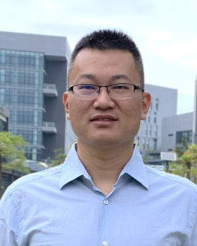
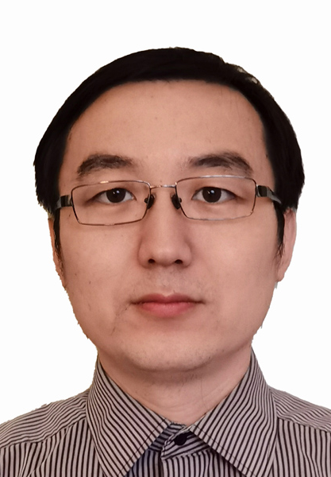
GTIIT Researchers affiliated with SEHM
Researcher | Program | SEHM as first priority | SEHM as second priority | Research background and lines and comments
Yuanshen Qi | Materials Science and Engineering |  | X | Nanostructured Materials, Nanowhiskers, Nanoparticles, Ferroelectric Materials, Interphase and Intergranular Boundaries, Solid State Dewetting of Thin Films, Electroplasticity & Electromigration
Zhujiang Wang | Mechanical Engineering (Robotics) | X |  | Solid Mechanics, Lightweight Lattice Structure, Rapid Prototyping, Medical Devices, Medical Simulations
Mingyi Liu | Mechanical Engineering (Robotics) | X |  | Mechatronics, Energy harvesting and renewable energy, sensors and instruments, Vibrations, dynamic and control

Slide 5
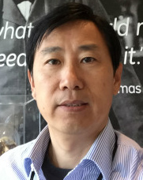
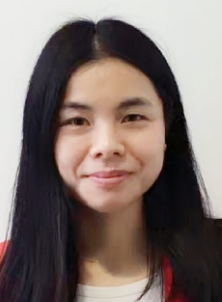
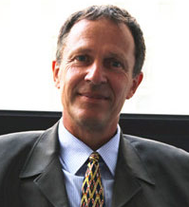
GTIIT Researchers affiliated with SEHM
Researcher | Program | SEHM as first priority | SEHM as second priority | Research background and lines and comments
Daniel Tan | Materials Science and Engineering |  | X | Nanodielectric composites and interface phenomena, Energy storage and electrochemical supercapacitors, Polymer film and membrane, Piezoelectric conversion materials, Microwave dielectric ceramics
Yan Wang | Chemical Engineering | X |  | Soft electronics, nanomaterials, materials design, nanofibers/wires, flexible/interface design, mechanical engineering, smart textiles, energy devices, electronics skins, biomedical sensors, health monitoring, human-machine interfaces
Klaus-Dieter Liss | Materials Science and Engineering |  | X | Common Materials Aspects, Thermo-Mechanical Processing and Extreme Conditions, Response of Materials to External Stimulation, Novel Possibilities with Quantum Beams

